Slide 1


Predicting Health Insurance Charges: Identifying the Key Drivers of Insurance Costs
Notes:
My name is Amy Hatman, and today I’ll be walking you through my data science project focused on predicting individual health insurance charges using machine learning.

Slide 2

introduction
Notes:
Let’s begin with the big picture: Health insurance pricing affects nearly everyone, yet the way these costs are estimated is often based on averages or outdated methods. My goal with this project was to explore whether we could use modern predictive tools to make those estimates more accurate and fair—both for insurers and for the people they insure.

Slide 3

Business problem and motivation
Notes:
The business challenge here is twofold: First, insurance companies need to accurately price policies to stay profitable. Second, there’s growing pressure to make sure that pricing is fair and transparent. Traditional models don’t always capture the complex relationships between a person’s lifestyle, health metrics, and future healthcare costs.
That led to the central question behind this project: Can we use basic personal data—like age, BMI, and smoking status—to better predict a person’s medical insurance charges?

Slide 4

Data set
Notes:
To explore that question, I used a dataset from Kaggle containing information on 1,338 individuals. The features included age, sex, BMI, number of children, region, smoking status, and annual medical charges. Importantly, there were no missing values, and the data was clean and ready for analysis.
I encoded the categorical variables and used charges as our target variable. This allowed us to build several regression models to explore the relationships between features and costs.

Slide 5
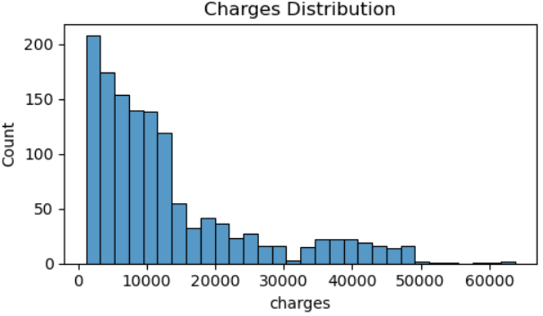
Notes:
Most insurance charges fall under $15,000, but a few individuals have extremely high costs, indicating a long-tail distribution.

Slide 6
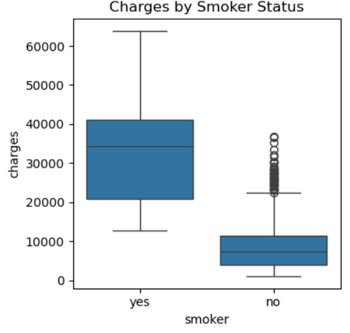
Notes:
Smokers have much higher medical costs than non-smokers. This confirms smoking as a major cost driver.

Slide 7
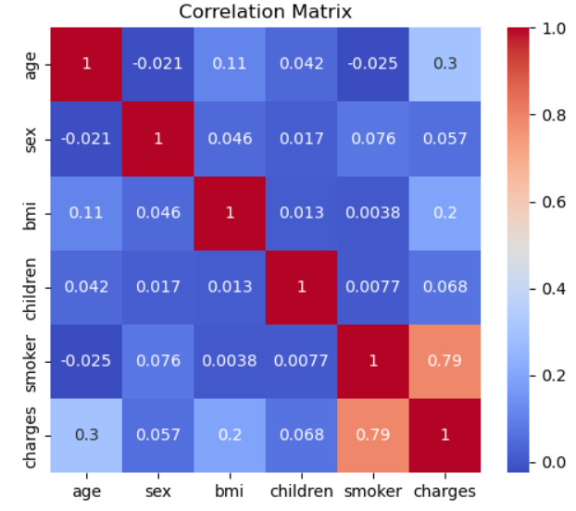
Notes:
Smoking, age, and BMI have the strongest positive correlation with charges, while other features have weaker relationships.

Slide 8

Methods and tools
Linear Regression
Random Forest
Gradient Boosting
Notes:
I started with exploratory data analysis to understand how different features were distributed and how they related to charges. Then we built several predictive models:
A simple Linear Regression model to serve as my baseline.
Random Forest and Gradient Boosting models to capture more complex, non-linear patterns.
I also tried classification models to see if we could predict who was a smoker based on other data, and we explored clustering to see how naturally different groups formed.
Everything was implemented in Python, using libraries like Pandas, Seaborn, Scikit-learn, and Matplotlib.

Slide 9

Gradient boosting regressor
RMSE 4336.65
R^2 0.88
MAE 2457.19
Notes:
Gradient Boosting is a powerful machine learning technique that builds a model step-by-step, where each new decision tree tries to correct the errors made by the ones before it. Unlike traditional models that look at all features at once, Gradient Boosting learns from mistakes iteratively, gradually improving accuracy.
In this project, Gradient Boosting was used to predict insurance charges. It outperformed both Linear Regression and Random Forest models:
R² Score: 0.88
Root Mean Square Error (RMSE): ~$4,330
Mean Absolute Error (MAE): lower than other models
These metrics show that Gradient Boosting explained 88% of the variation in medical charges, making it the most accurate model we tested.
The model also helped identify the most important features:
Smoker status was the top predictor.
BMI and age followed as strong indicators.
Other factors like region or gender had minimal influence.

Slide 10
results
Notes:
The biggest takeaway is that smoking status is by far the most powerful predictor of insurance charges. On average, smokers were charged 4 to 5 times more than non-smokers.
BMI and age were also important. Heavier and older individuals tended to have higher costs, especially if they also smoked. On the other hand, gender and region had relatively little influence.
In terms of model performance, Gradient Boosting gave us the best results with an R-squared of 0.88 and an RMSE just above $4,300.
Interestingly, our attempt to predict smoker status based on other features didn't go well—the model performed poorly, which tells us smoking isn't easily predictable using demographic or physical data alone.

Slide 11

Ethical considerations
Notes:
This project also raises ethical questions. For example, while smoking is a legitimate risk factor, there’s a fine line between using it for fair pricing and making insurance unaffordable for some people. Transparency and fairness are critical when using models that directly affect people's financial lives.
To address that, I avoided sensitive or protected attributes like race and emphasized interpretability throughout.

Slide 12
Applications and next steps
Notes:
This model could help insurance companies design better pricing tools, target wellness programs, or detect anomalies like fraud. But to really move forward, we’d need richer data—like medical history or behavioral data—and strong privacy safeguards.
Future improvements could include more advanced modeling techniques, fairness audits, and deploying explainable AI tools to support human decision-makers.

Slide 13

conclusion
Notes:
In closing, this project showed that with the right tools and data, we can make health insurance pricing more accurate, more fair, and more useful for everyone involved. It’s a small but meaningful step toward smarter, data-driven healthcare systems.
Thank you for your time. I’m happy to take any questions.
Questions: Why did you pick the Gradient Boosting model instead of something simpler? Gradient Boosting gave me the best results. It handled complex patterns in the data better than simpler models like Linear Regression, especially when multiple features like age and BMI interact with each other.
Did you check if the model works equally well for different groups of people, like older adults or people from different regions? Yes, I looked at model performance across variables like age and region. Smoking and BMI had the strongest influence, but results stayed consistent across regions.
What did you do about data points that looked really different or extreme, like very high charges? I visualized and checked for outliers, especially very high insurance charges. While I didn’t remove them, I used models like Gradient Boosting that are more robust to those extreme values.
Which mattered more for predicting cost—being a smoker or having a high BMI? Smoking was the biggest cost driver by far. BMI also mattered, especially in combination with smoking, but smoking alone caused a much bigger jump in charges.
Why couldn’t your model figure out who was a smoker? Isn’t that kind of important? Good question. The model couldn’t predict smoking status because the other features didn’t provide enough clear clues. It’s likely that smoking behavior is independent of things like age or BMI in this dataset.
How do you make sure the model isn’t unfair to certain groups of people? I avoided using sensitive features like race. I also checked model outputs across groups and recommended fairness checks if this were deployed in the real world.
Would adding things like medical history make the model better, and is it okay to use that kind of private info? Yes, medical history would definitely improve accuracy. But using that data must be done carefully—with consent, privacy protections, and clear ethical guidelines.
If an insurance company wanted to use this model, how would they actually do that? They could integrate it into their pricing system by feeding in customer info and using the model to suggest risk-based pricing. They’d also need tools to explain the predictions to both staff and customers.
How often would they need to update or retrain it to keep it accurate? It’s best to retrain the model regularly—maybe every 6–12 months—to account for changes in health trends, policy, or population behavior.
What would change if you had more data, like step counts from a fitness tracker? That would likely improve predictions a lot. Behavior data like physical activity could help personalize risk scores more precisely and encourage healthier choices too.

